Slide 1
Computer Engineering Department
A.P. Shah Institute of Technology
G.B.Road,Kasarvadavali, Thane(W), Mumbai-400615 UNIVERSITY OF MUMBAI
Academic Year 2022-2023

Slide 2
Hospital Management System
A Project Report on
Submitted in partial fulfillment of the degree of
Bachelor of Engineering(Sem-VI)
in
Computer Engineering
By
Sana Sheikh (20102081)
Naman Shilotri (20102191)
Shravya Shetty (20102023)
Kartik Shukla (20102181)
Under the Guidance of
Prof. Deepak khachane

Slide 3
1.Project Conception and Initiation

Slide 4
1.1 Abstract
The Student Record System (SRS) is a user-friendly web application designed for educational institutions to manage student data. It includes two modules: one for administrators to manage courses, subjects, and student records, and one for users to view and update personal information and academic records. The system can be expanded to include a doubts section in the future. SRS is an efficient and valuable tool for educational institutions to manage their student records.

Slide 5
1.2 Objectives
Improve data management for educational institutions.
Enhance collaboration and communication between stakeholders.
Increase efficiency by automating manual processes and reducing paperwork.

Slide 6
1.3 Problem Definition
Manual processes and paper-based systems make managing student data a challenge for educational institutions. They require an efficient and user-friendly system to manage student records. The Student Record System (SRS) is a web-based platform built with PHP and MySQL, providing modules for administrators and users. Administrators can add and manage courses, subjects, and student records, while users can log in to view their personal information and academic records. SRS improves collaboration and eliminates inefficiencies, improving the quality of education.

Slide 7
1.4 Scope
Digital libraries are important for the information economy.
Absolute Journal is a project exclusively for the computer branch of A.P. Shah Institute of Technology.
It provides access to all subjects from all four years of engineering.
The platform offers notes from various teachers for the same subject to help students gain a better understanding of difficult topics.
The platform encourages students to share their ideas and notes, making it more interactive.

Slide 8
1.5 Technology stack
Front-end: HTML, CSS, JS
Back-end: PHP
Software used: XAMPP
IDE used: VSCODE
Database: MySQL

Slide 9
1.6 Benefits for environment & Society
The SRS is a web application designed to help educational institutions manage student records more efficiently.
The system is built using PHP and MySQL, two popular technologies for web application development.
It has two modules: one for administrators and one for users.
Administrators can add and manage courses, subjects, and student records, as well as personal, contact, and academic information for students.
Users can log in, view their personal and academic information, and update their records as necessary.
The SRS can help institutions save time and resources by improving their data management practices.
It can also enhance the learning experience for students by providing easy access to their records and information.
Future developments could include a doubts section where students can post their questions and administrators can respond to them.
Overall, the SRS is a valuable tool for educational institutions seeking to manage their student records efficiently and effectively.

Slide 10
2. Cloud Technology

Slide 11
2.1 Cloud Platform
We have opted to use Google cloud service to deploy our project on the cloud. This allows us to leverage the scalability, reliability, and security features of Google cloud to ensure seamless deployment and management of our project. With Google cloud, we can easily monitor and manage our resources, ensuring optimal performance and efficiency.

Slide 12
2.2 Services Used
IAM
VM
Cloud SQL
BUCKET

Slide 13
3.Implementation

Slide 14
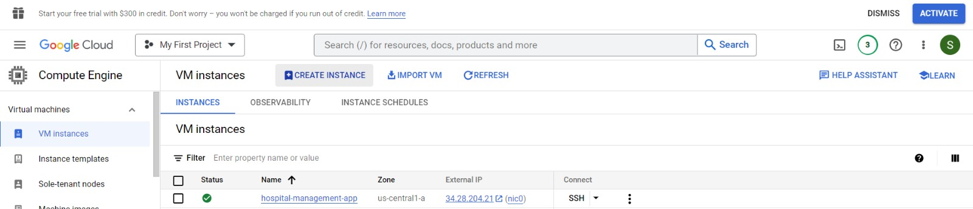
3.1 Execution

Slide 15
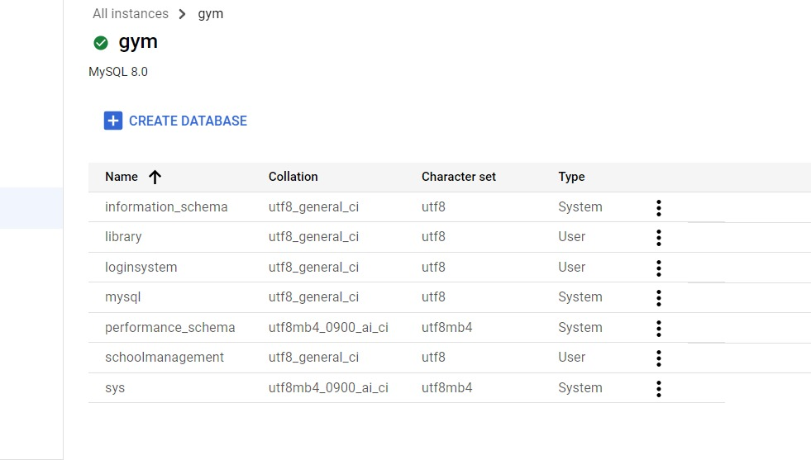
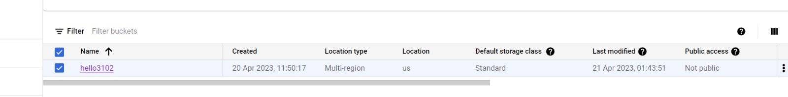

Slide 16
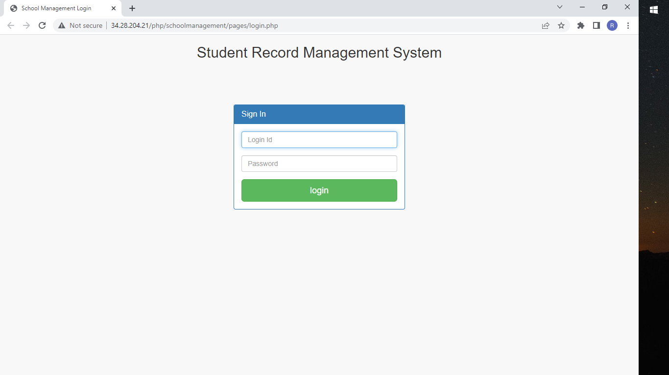

Slide 17
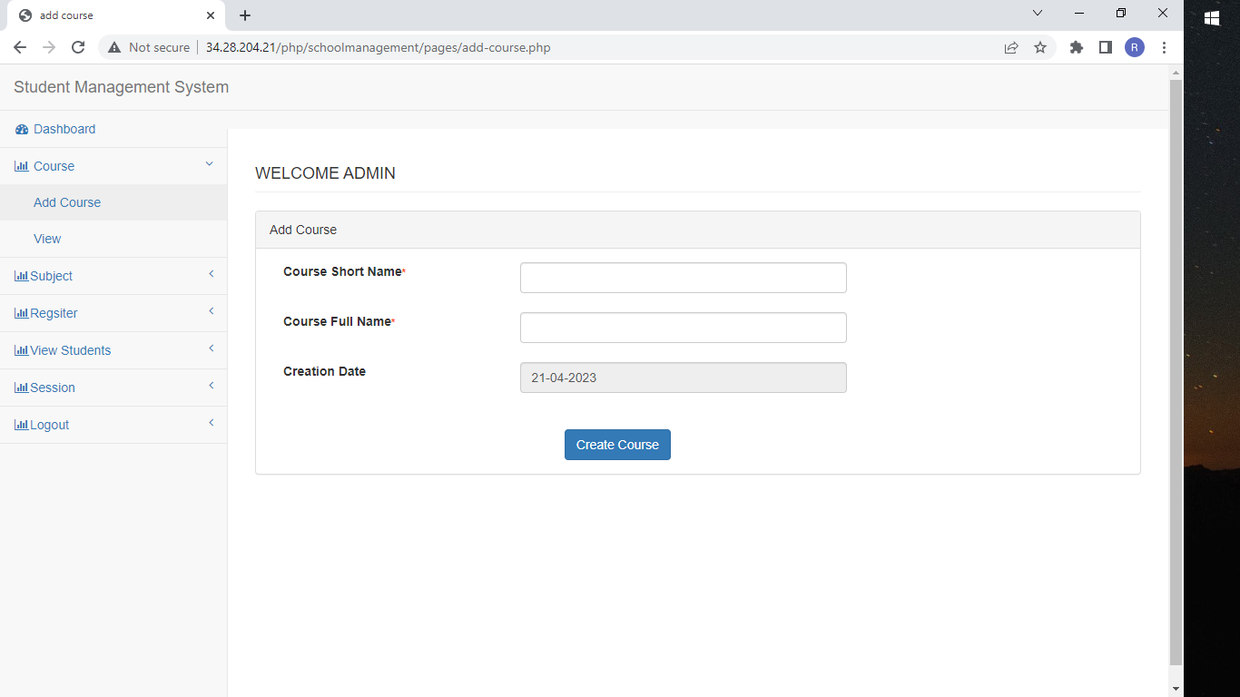

Slide 18
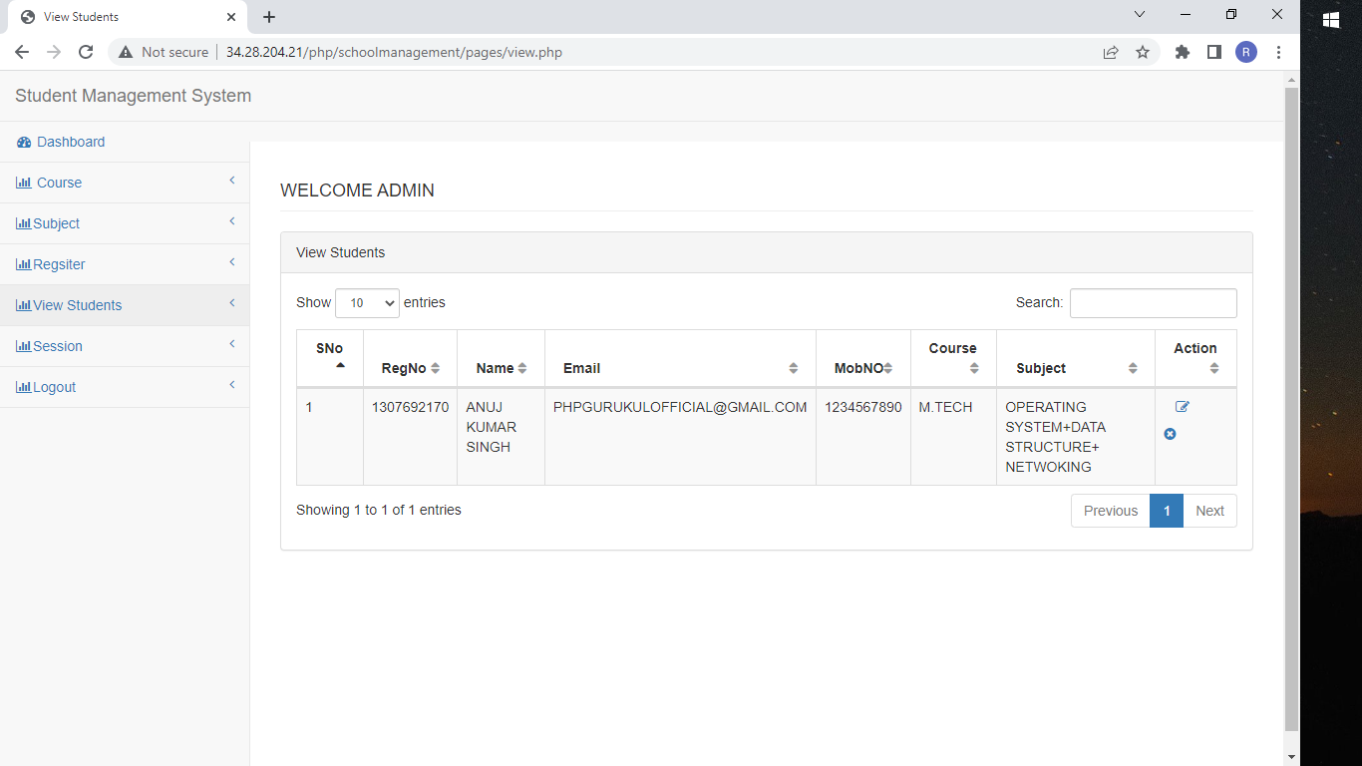

Slide 19
Demonstration and Code Links
https://github.com/Shravya2308/php

Slide 20
Thank You

